Slide 1

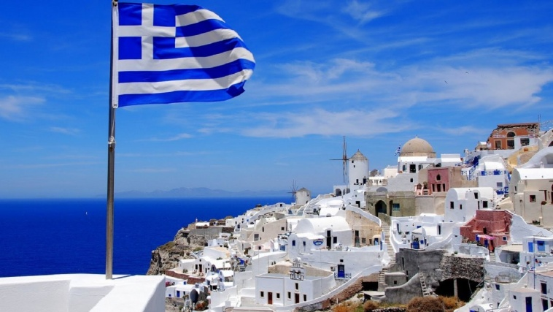
Greece (Hellas)
Our Country

Slide 2
The music of the presentation comes from the Greek composer Stamatis Spanoudakis and it has the title “Sea”.
The students of E’ class who cooperated for the presentation of our country are: Alexandros Ageloukos, Griselda Azis, Despina Velali, Evgenios Voulkoudis, Ilias Damasiotis, Rafael Dimopoulos, Ioanna Zabetoglou, Apostolia Zahou, Stelios Kokoris, Alexandros Kiritsis, Rafaelia Lada, Evaggelia Mitraka, Danae Bonou, Dimitrios Parisis, John Sarakatsianos, Konstantinos Tzanis, Marios Trsantilis, Marina Fakiola, Konstantinos Filippopoulos
with the help of the teachers of our school:
Victoria Delistathi, Ariadni Porpoda and Lampros Sdrolias

Slide 3
Population, Geographical Features & Weather

Slide 4
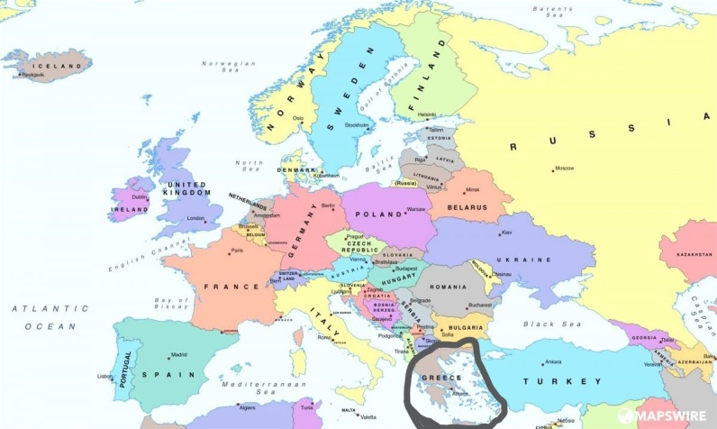
Greece is located in South-east Europe,
part of the Balkan peninsula.

Slide 5
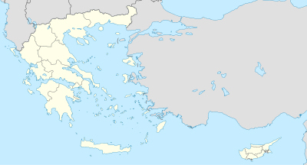
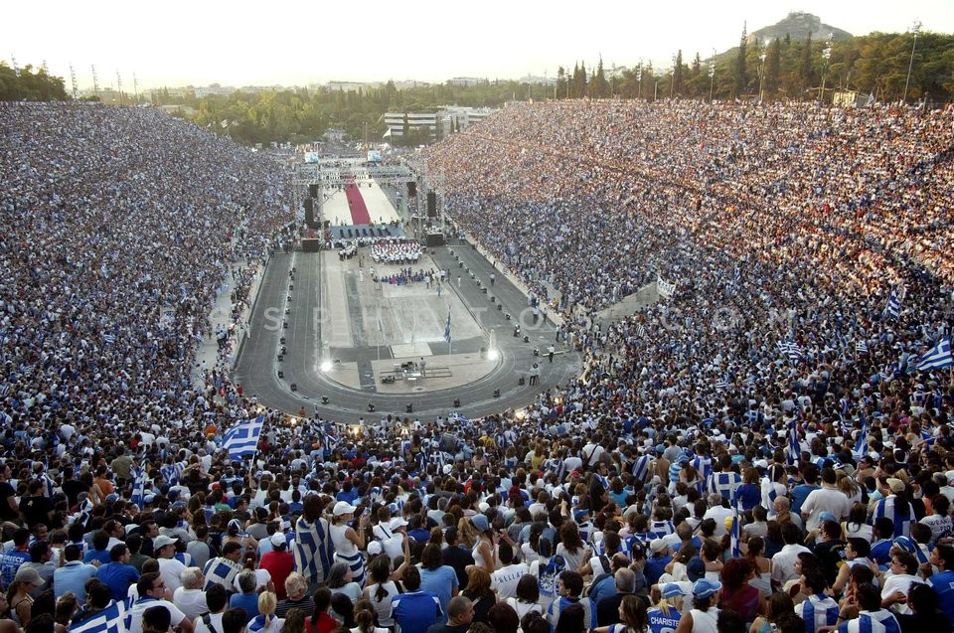
The country’s population is about 10,5 million people and the land area is 131.944 square kilometers.

Slide 6
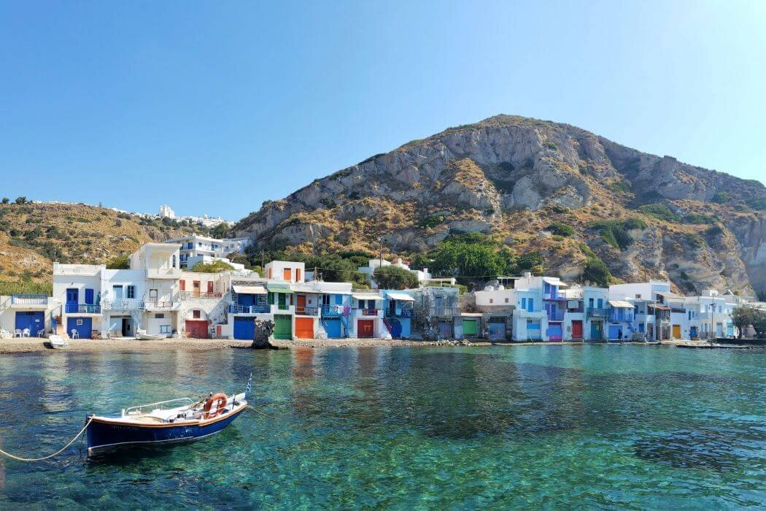
The climate is primarily Mediterranean with mild, wet winters and hot and dry summers.

Slide 7
National Symbols, Language

Slide 8
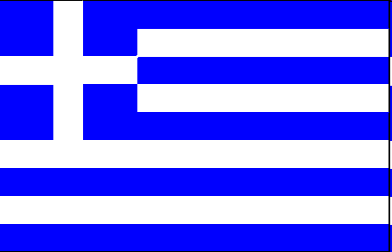
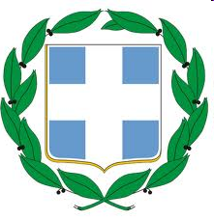
Our flag consists of nine horizontal stripes – five blue and four white- which alternate.
On the top left corner there is a white cross. According to popular tradition, the nine stripes represent the nine syllables of the phrase Ελευθερία ή Θάνατος ("Freedom or Death"), the five blue stripes for the syllables “Ελευθερία” and the four white stripes “Θάνατος”.
The nine stripes are also said to represent the letters of the word "freedom" (Greek: ελευθερία- eleftheria). The blue and the white symbolize the colours of the famous Greek sky and sea, combined with the colors of the clouds and waves.
The National Emblem of the Republic of Greece consists of a blue escutcheon(looks like a shield) with a white cross in the centre, completely surrounded by two laurel branches.

Slide 9

The official language of Greece is “Greek” and has been used for writing since the 8th century BC.
There are 24 letters-each in uppercase and lowercase forms- and it consists of 17 consonants and 7 vowels.

Slide 10
Greetings
Hello --- Γεια (gia)
Good morning --- Καλημέρα (kalimera)
Good night --- Καληνύχτα (kalinihta)
Happy Birthday --- Χρόνια Πολλά (hronia pola)
How are you? --- Τι κάνεις ; (ti kanis)

Slide 11
Currency, Political System & EU

Slide 12
The official currency of Greece is the euro ( €) .

Slide 13
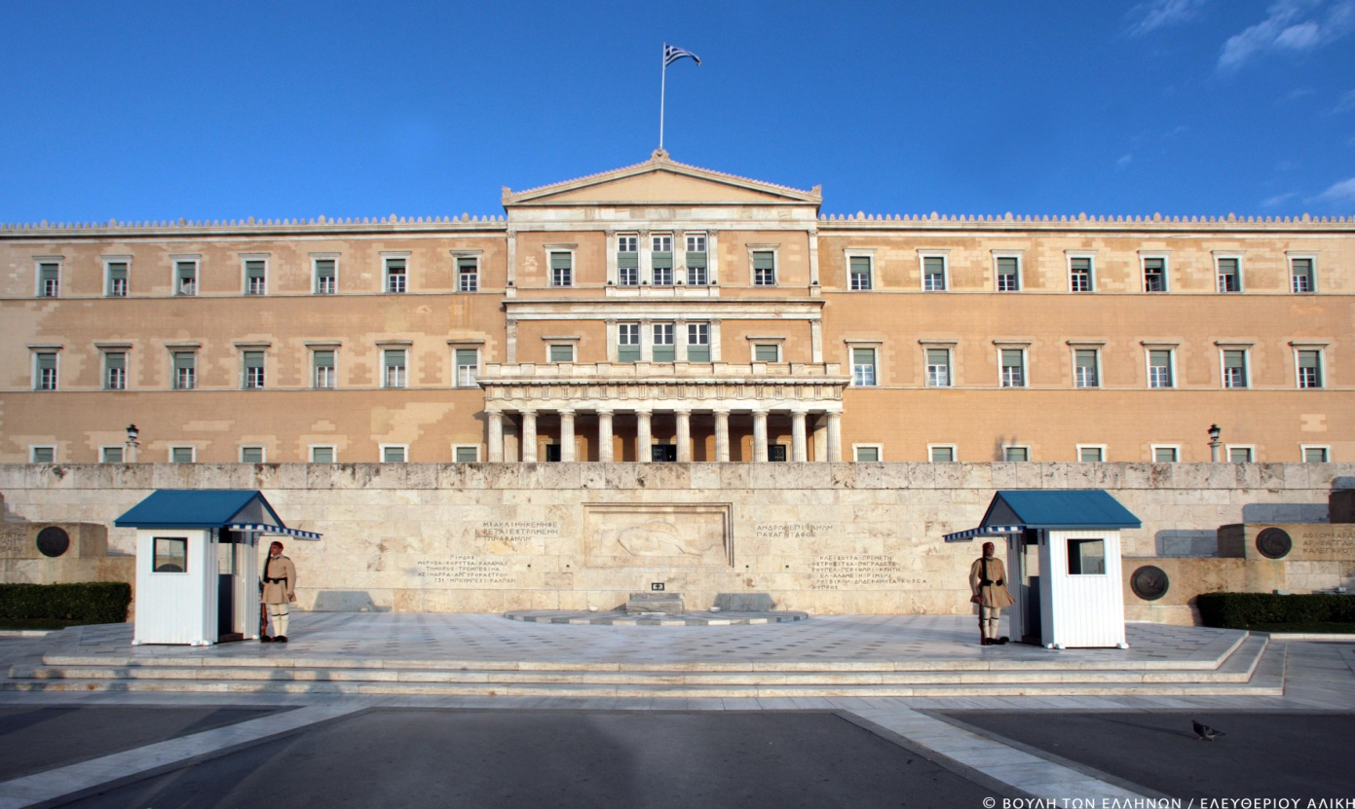
The political status in Greece is “Presided parliamentary democracy”.

Slide 14
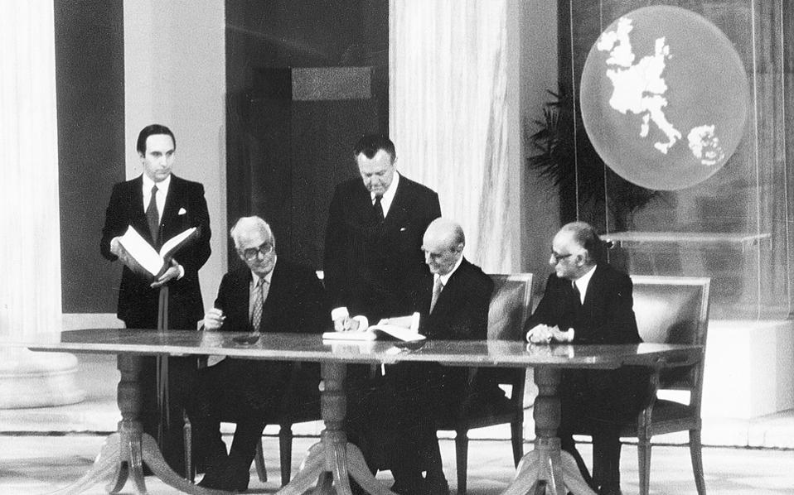
Full accession of Greece in the European Union took place on the 1st of January 1981, making Greece the 10th member to join.

Slide 15
Capital, Main Cities & Landmarks

Slide 16
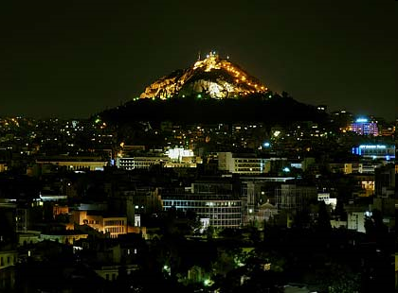
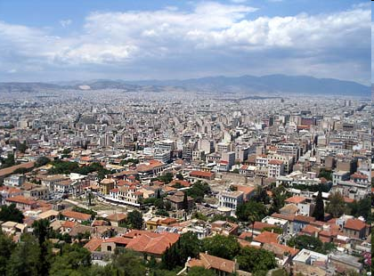
Athens is the capital of Greece since 1834 and the biggest city in the country. It is named after the goddess “Athena”. It also has a population of about 4 million people.

Slide 17
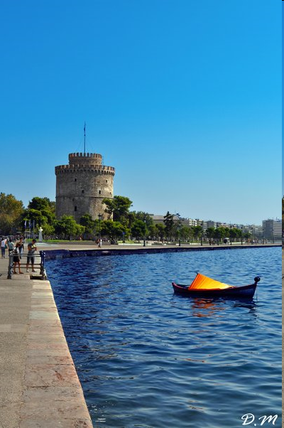
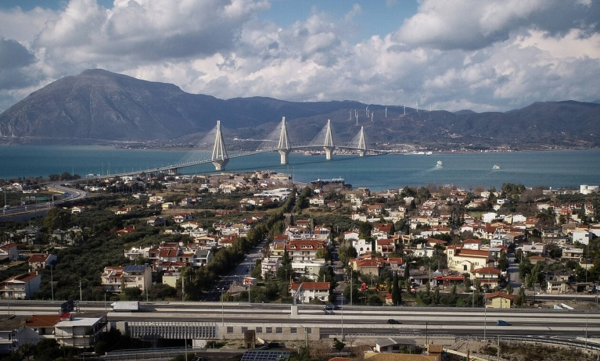
Thessaloniki is the second largest city in Greece. It is situated in Macedonia.
Patras is a big city in Peloponnese and connects Greece with Europe via its big port.

Slide 18
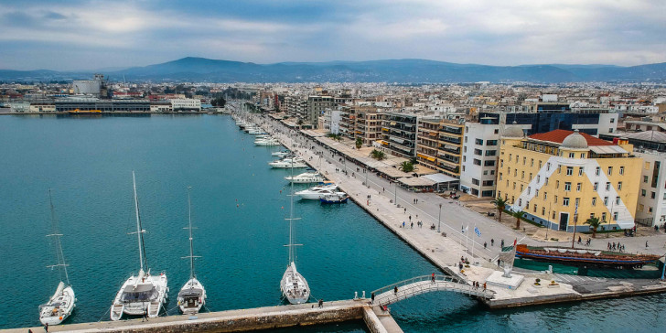
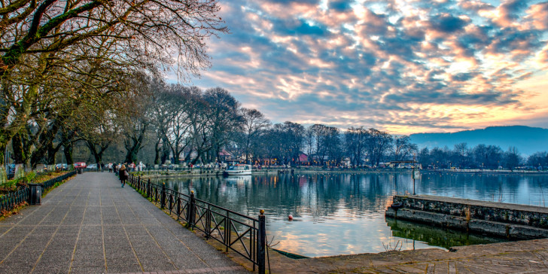
Volos is our city. It’s situated by the sea, in the region of Thessaly.
Ioannina lies in Epirus and it is built on the shore of lake Pamvotis.

Slide 19
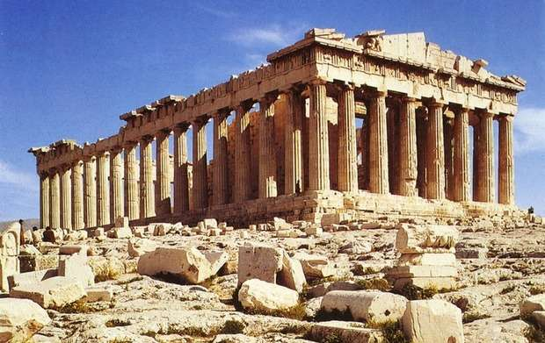
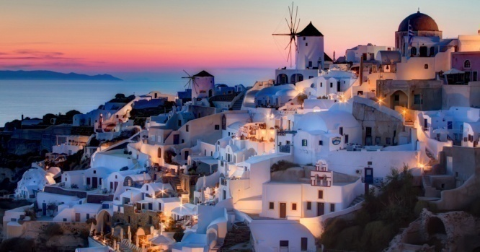
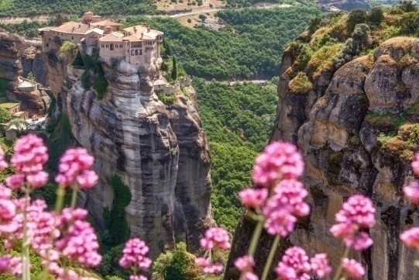
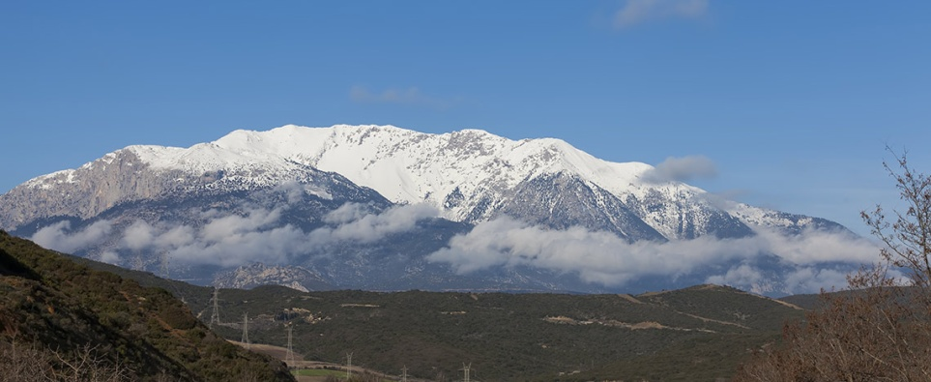
The Parthenon was built in Athens ,in honor of the goddess Athena.
Santorini or Thira is an island in the Aegean Sea and it’s built upon the crater of a volcano.
Meteora is a formation of dark sandstone rocks that rise outside Kalambaka. A complex of monasteries are built on top of these unique columns of rock.
Parnassos is one of the highest Greek mountains in central Greece. It is famous for the National Park and its modern ski resort.

Slide 20
Religion, Tradition & Interesting Historical Facts

Slide 21
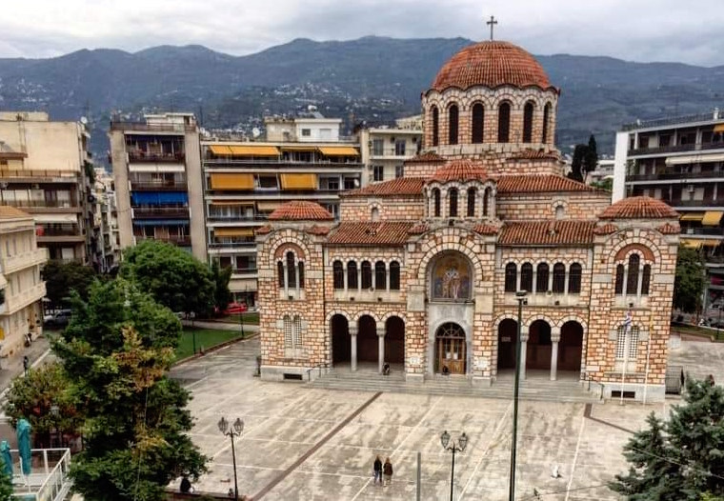
The official religion in Greece is the Eastern Orthodox church of Christ.

Slide 22
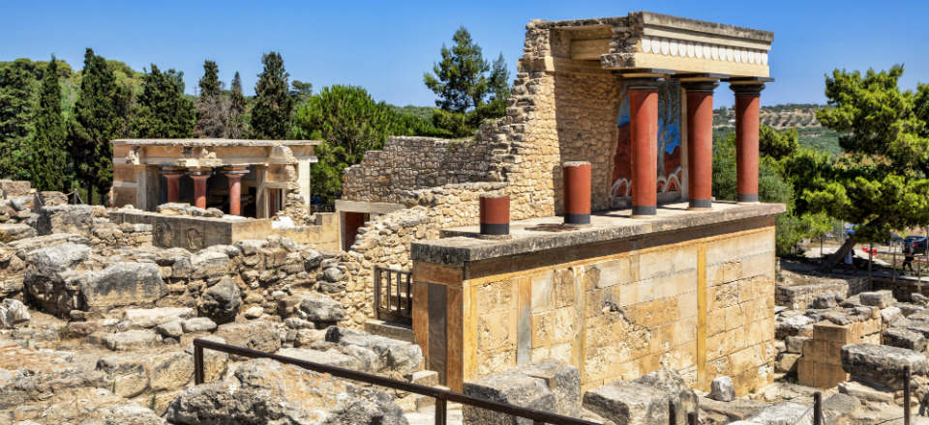
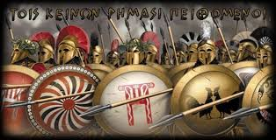
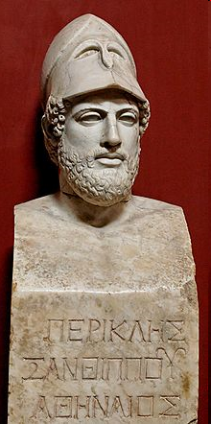
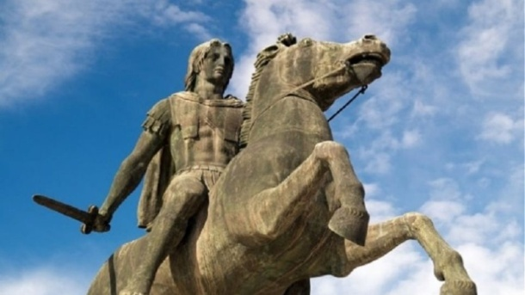
The Minoan civilization is the first advanced civilization in Europe and flourished in Crete.
During wartime against the Persians, ancient Greek generals became famous such as Miltiades at the battle of Marathon, Leonidas in Thermopiles and Themistocles at the naval battle of Salamina.
Pericles was an ancient Greek Athenian politician, orator and general of the 5th century BC. During his leadership civilization reached its peak and and Democracy was established.
Alexander the Great was the king of Macedonia in Greece. Being brave and undefeated in battles, managed to expand his empire to India.

Slide 23
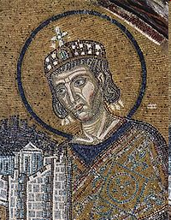
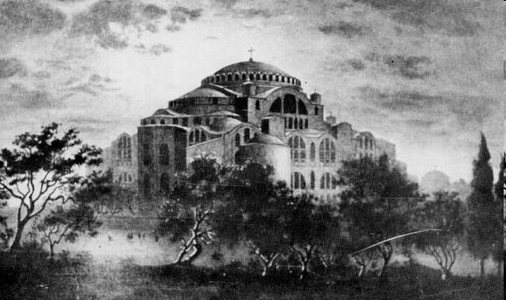
The temple of ‘‘Agia Sofia” is the symbol of Konstantinople and it was built during the Byzantine historic period.

Slide 24
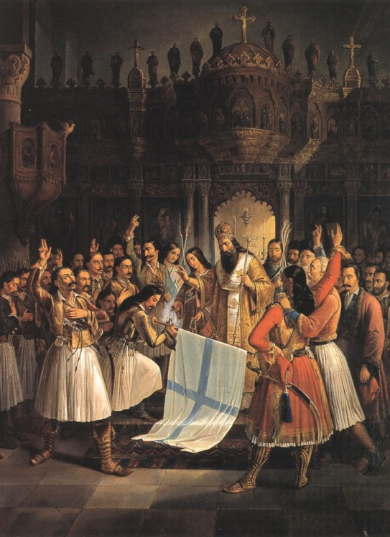
The Greek Revolution in 1821 took place in order to get rid of the Ottoman Rule and be able to create an independent state.

Slide 25
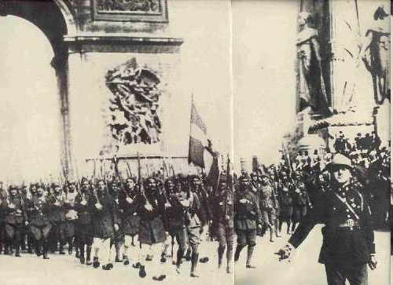
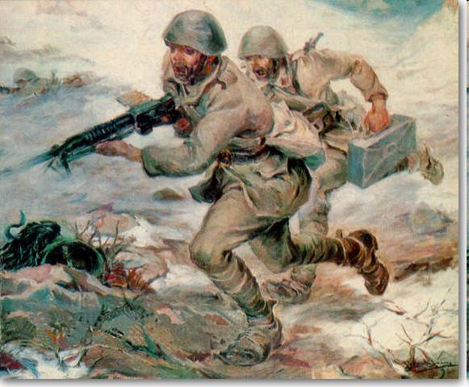
Greece was involved in both the First World War and the Second World War by the side of the winners.

Slide 26
Famous People Known Worldwide

Slide 27
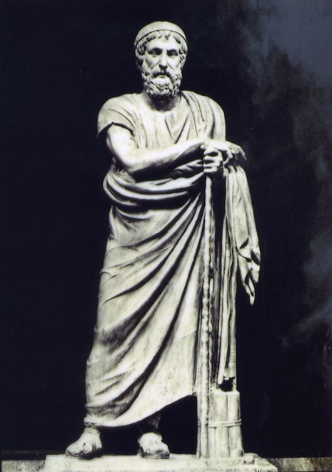
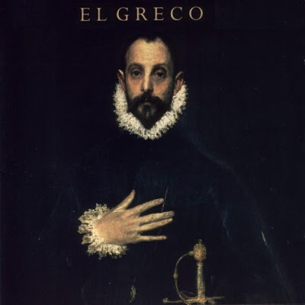
Homer is the greatest poet of all time. He is the writer of Iliad and Odyssey.
Dominikos Theotokopoulos (known as El Greco) was a painter of the Spanish Renaissance , born in Heraklion of Crete.

Slide 28
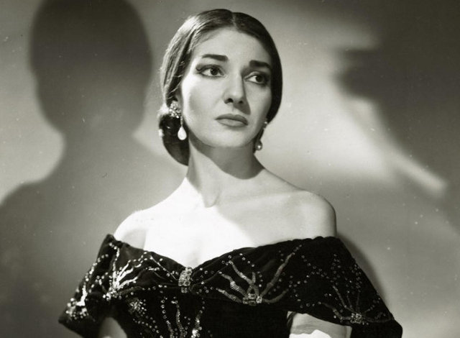
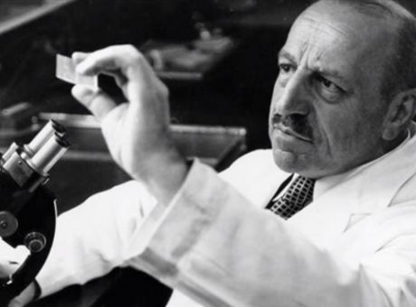
Maria Kallas was a great Greek vocalist, the ultimate diva in the field of lyric theatre.
Georgios Papanikolaou was a doctor of Greek origin. He became known for his invention of the Papanikolaou test( Pap test), which is used worldwide for the detection and prevention of cancer in the female reproductive system.

Slide 29
Food / Sport / Entertainment

Slide 30
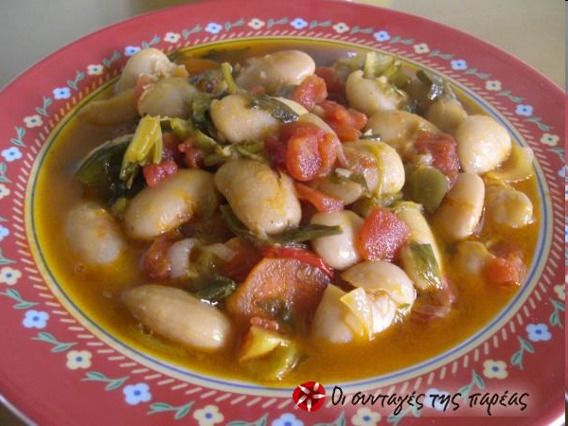
Bean soup is Greece’s national dish and belongs to pulses. It is often cooked in winter time. The ingredients for this soup are dry beans, carrots, celery onion, tomato juice, a little salt and pepper and of course olive oil. It is always served warm with some lemon juice. Good appetite!

Slide 31
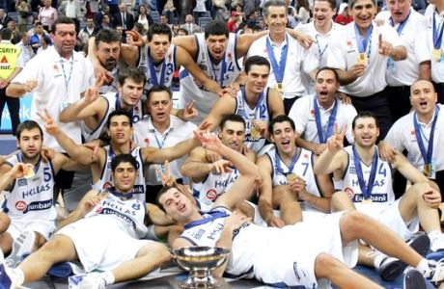
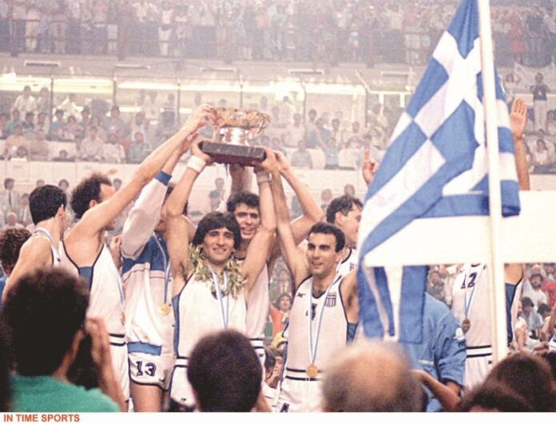
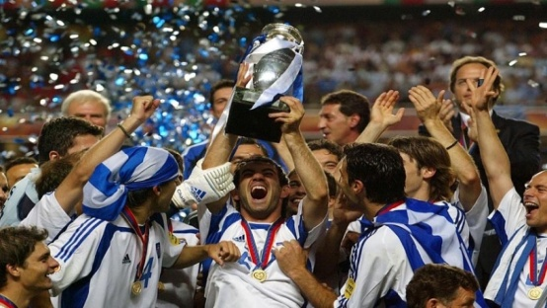
The National basketball team of Greece won the European championship twice, in 1987 and in 2005.
Greece’s representative football team stepped on the throne of Europe in 2004.

Slide 32
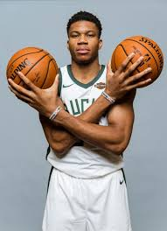
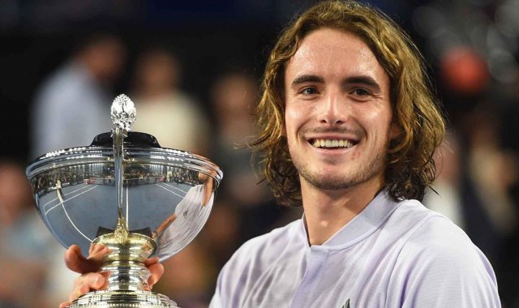
Giannis Antetokounmpo – an NBA basketbal player – Milwaukee Bucks-has been an MVP (Most Valuable Player) for two consecutive years (2019 & 2020).
Stefanos Tsitsipas is, at the moment, one of the top five tennis players in the world.

Slide 33
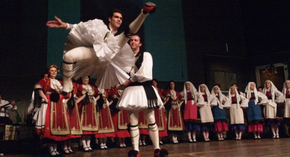
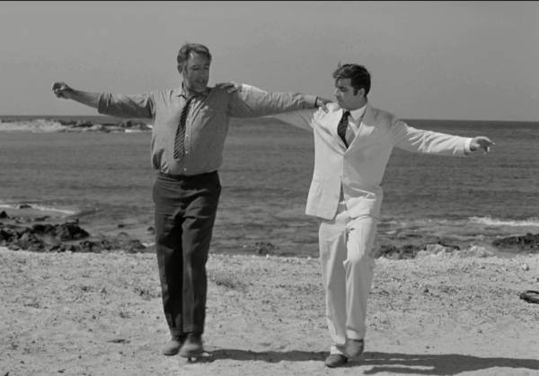
“Tsamikos” is one of the most characteristic traditional dances of Greece.
“Syrtaki” is a modern Greek dance. It became famous from the movie “Zorbas” as well as the great musical work of the well-known music composer Mikis Theodorakis.

Slide 34
Famous Folktales, Myths & Legends

Slide 35
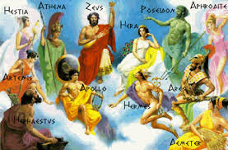
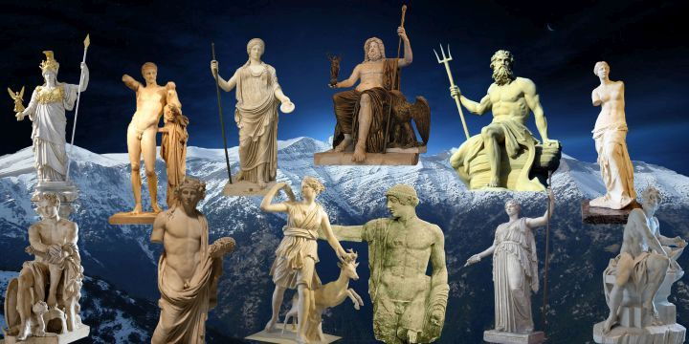
Ancient Greeks worshipped their gods who lived on the highest mountain in Greece, Olympos.

Slide 36
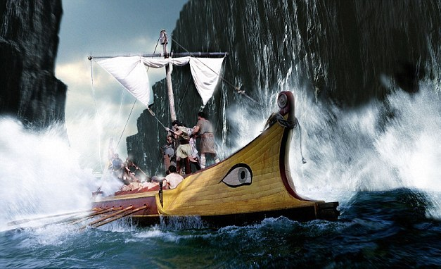
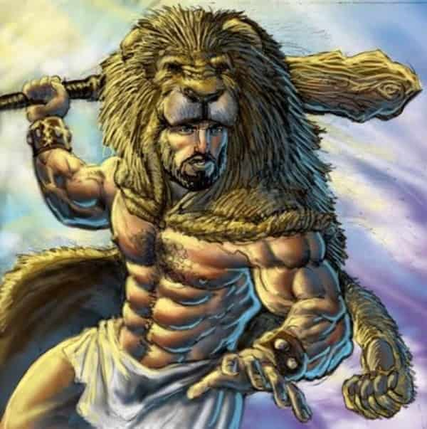
In the myths and legends of the ancient Greek people, Hercules and Jason hold an important place. The first one because of his supernatural powers and the second for his trip in the quest for the “Golden Fleece” which began from our city, Volos.

Slide 37
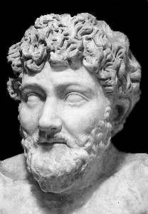
The greatest storyteller and fable maker of Greece is Aesop. His fables not only amuse but also teach children from the ancient times until today.

Slide 38
Other interesting facts

Slide 39
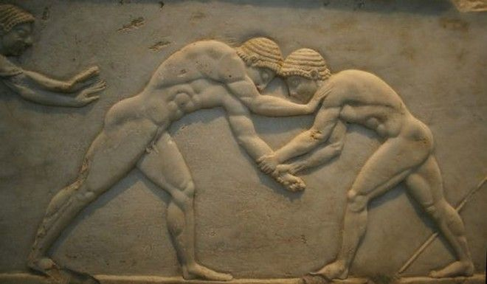
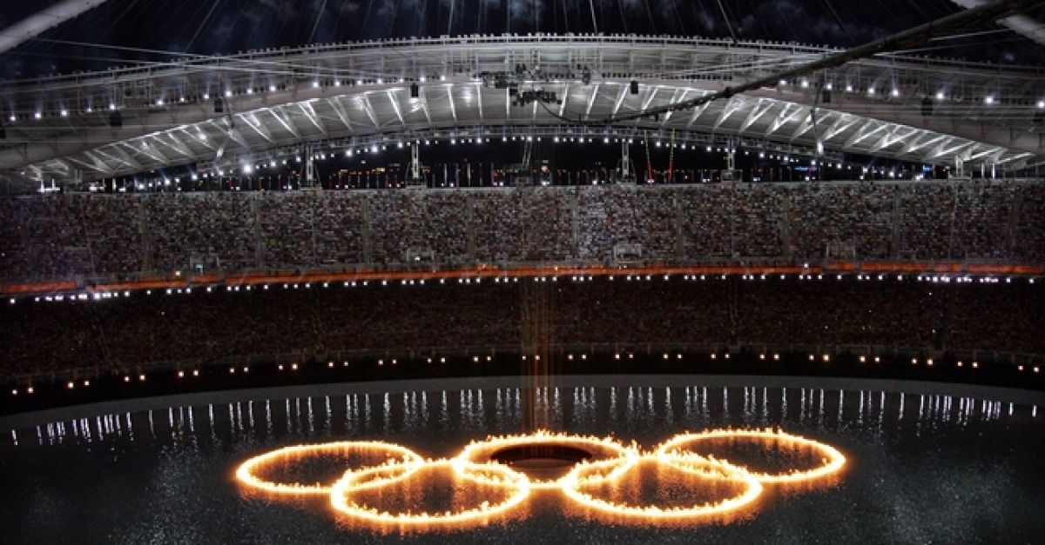
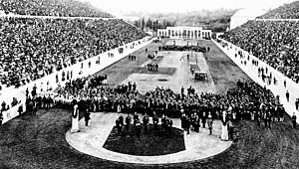
The Olympic Games originate in Greece. In the modern times, they were relived in 1896.The first modern Olympics took place in Athens and then again in 2004.

Slide 40
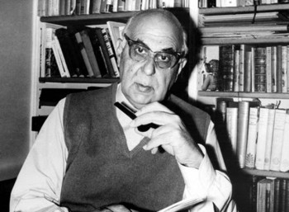

Greek Literature has been honored with two Nobel prizes until now. The poet George Seferis was awarded the prize in 1963 and Odysseus Elytis in 1979.

Slide 41

Γεια σας από την Ελλάδα!!!

